Slide 1

The Atomic Human
Understanding Ourselves in the Age of AI
Neil D. Lawrence

Slide 2


Slide 4

Notes:
The Diving Bell and the Butterfly](https://www.penguinrandomhouse.com/books/9616/the-diving-bell-and-the-butterfly-by-jean-dominique-bauby/) is the autobiography of Jean Dominique Bauby. Jean Dominique was the editor of the French Elle magazine, in 1995 at the age of 43, he suffered a major stroke. The stroke paralyzed him and rendered him speechless. He was only able to blink his left eyelid, he became a sufferer of locked in syndrome.

Slide 5
E S A R I N T U L
O M D P C F B V
H G J Q Z Y X K W

Slide 6
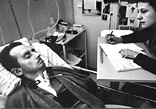

Slide 7
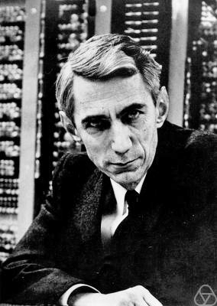
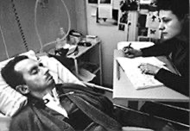

Slide 8
bits/minute
6
2000
billions
a billion
billion
a billion
billion
calculations/s
trillions
5 trillion
years
15 billion
years
20
minutes
embodiment

Slide 9
?
!#@%&?
#
!
&
!
£*?$&!
&
?
#

Slide 10

No
!#@%&?
!
No
Notes:
Image source: https://www.flaticon.com/free-icon/brain-inside-human-head_30609, http://res.publicdomainfiles.com/pdf_view/108/13955796621856.png

Slide 11
classical
statistics
data
science

Slide 12

For Sale, Baby Shoes, Never Worn

Slide 13
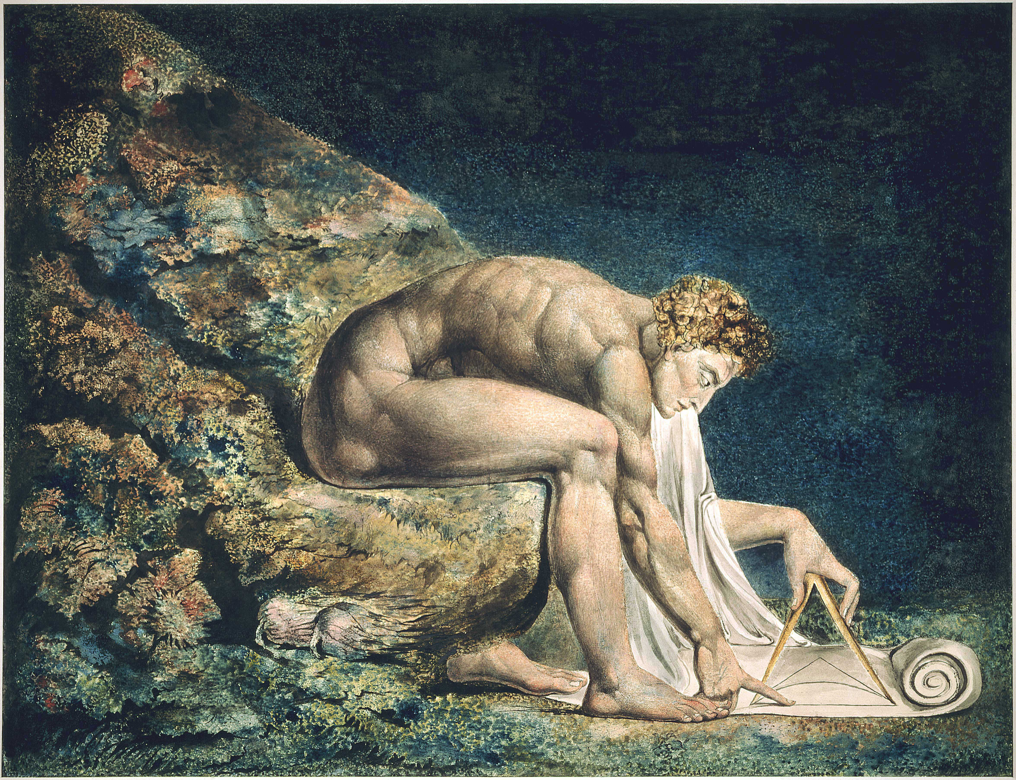

Slide 14

Notes:
The ”Blue Marble” photographed by Apollo 17.

Slide 15
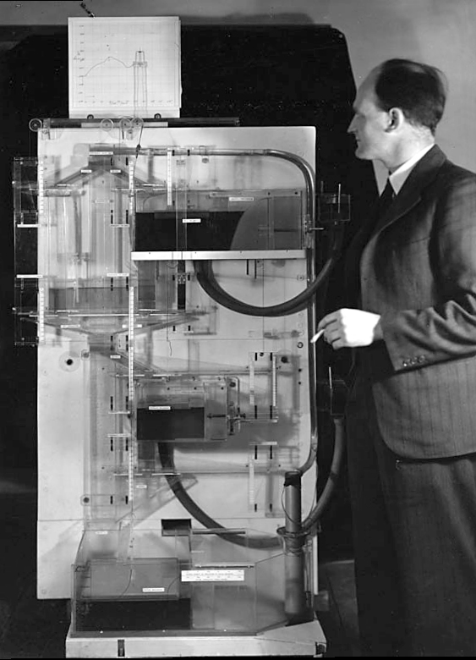
Notes:
Bill Phillips standing next to the MONIAC (completed in 1949)

Slide 17
psychology
classical
statistics
artificial
intelligence
data
science

Slide 18
bits/minute
100 x 10⁻⁹
2000
600 x 10⁹

Slide 19
complexity
bandwidth

Slide 20






Slide 21
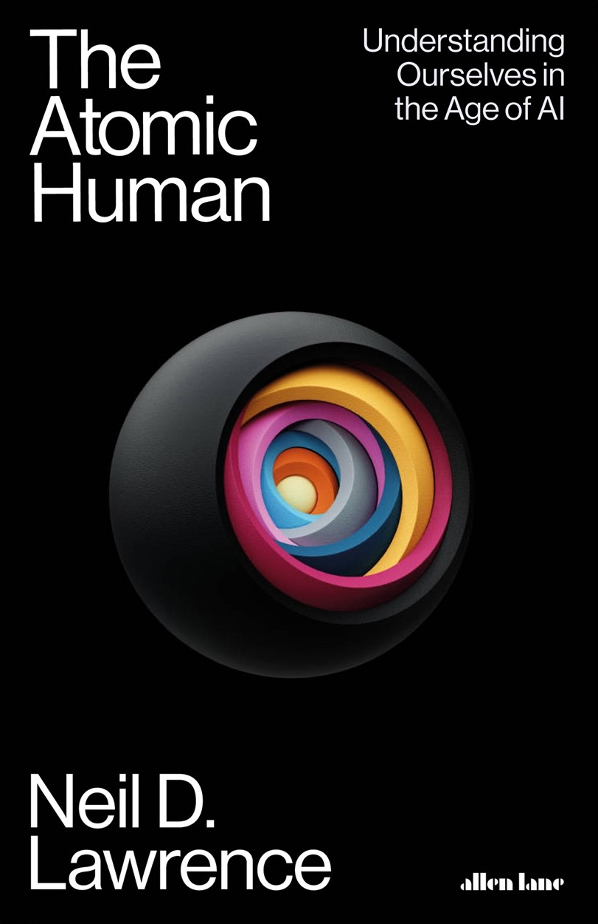
Available Now!
Thanks!

